Slide 1


Session on Industry standards - HL7, DICOM
Jaswanth Kumar V
Program Manager

Slide 2
HL7 Summary
HL7 uses TCP to send data
HL7 Messages ADT, ORM, ORU,ACK
HL7 Segments MSH, PV,PID NK, OBR,OBX
HIS - Hospital Information System
Modality – MRI, CT, X-Ray

Slide 3
What is DICOM

Slide 4
What is DICOM
Digital Imaging and Communications in Medicine
Is the standard for the communication and management of medical imaging information and related data.
DICOM is most used for storing and transmitting medical images
DICOM is a standard developed by American College of Radiology (ACR) and National Electrical Manufacturers Association (NEMA).
The National Electrical Manufacturers Association (NEMA) holds the copyright to the published standard
ISO standard 12052:2017
DICOM is used worldwide to store, exchange, and transmit medical images.

Slide 5
Why DICOM
DICOM (Digital Imaging and Communications in Medicine) is a standard protocol for the management and transmission of medical images and related data.
DICOM is the international standard to communicate and manage medical images and data. Its mission is to ensure the interoperability of systems used to produce, store, share, display, send, query, process, retrieve and print medical images, as well as to manage related workflows.

Slide 6
Dicom History
ACR and NEMA joined forces and formed a standard committee in 1983. – V1
Its goal in developing a standard was
To enable users to retrieve images and associated information from digital imaging equipment in standard format using point to point connection.
To hide differences same across multiple image equipment manufactures
To handle developing network and image standards, a new standard DICOM was proposed in 1981.

Slide 7
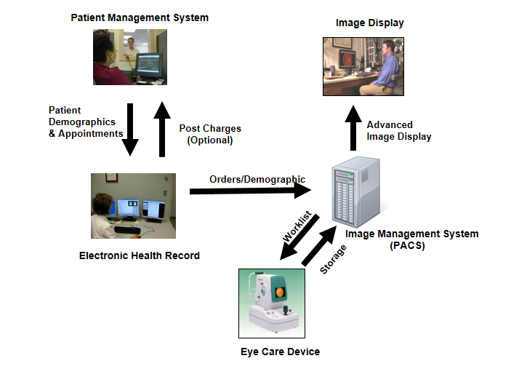
DICOM application domain

Slide 8
DICOM VR (Value Representer)
VR Name | Definition | Length of Value
AE | Application Entity, A string of characters | 16 bytes maximum
DA | A string of characters of the format YYYYMMDD | 8 bytes fixed
DT | Date Time A concatenated date-time character string in the format: YYYYMMDDHHMMSS.FFFFFF&ZZXX | 26 bytes maximum
FL | Floating Point Single | 4 bytes fixed
PN | Person Name Eg: Rev. John Robert Quincy Adams, B.A. M.Div. "Adams^John Robert Quincy^^Rev.^B.A. M.Div." | 64 chars maximum per component group

Slide 9
DICOM services
ECHO
FIND
STORE
GET
MOVE
COMMIT

Slide 10
SOP Classes
SOP Class UID | SOP Class Name
1.2.840.10008.5.1.4.1.1.6.1 | Ultrasound Image Storage
1.2.840.10008.5.1.4.1.1.3.1 | Ultrasound Multi-frame Image Storage
1.2.840.10008.5.1.4.1.1.77.1.5.1 | Ophthalmic 8-bitPhotography Image Storage
1.2.840.10008.5.1.4.1.1.77.1.5.2 | Ophthalmic 16-bitPhotography Image Storage
1.2.840.10008.5.1.4.1.1.88.33 | Stereometric Relationship Storage
1.2.840.10008.5.1.4.1.1.77.1.5.4 | Ophthalmic Tomography Image Storage
1.2.840.10008.5.1.4.1.1.82.1 | Corneal Topography Map Storage
1.2.840.10008.5.1.4.1.1.77.1.5.6 | Wide Field Ophthalmic Photography 3D Coordinates Image Storage

Slide 11
Image Storage SOP Classes
SOP Class UID | SOP Class Name
1.2.840.10008.5.1.4.1.1.6.1 | Ultrasound Image Storage
1.2.840.10008.5.1.4.1.1.3.1 | Ultrasound Multi-frame Image Storage
1.2.840.10008.5.1.4.1.1.77.1.5.1 | Ophthalmic 8-bitPhotography Image Storage
1.2.840.10008.5.1.4.1.1.77.1.5.2 | Ophthalmic 16-bitPhotography Image Storage
1.2.840.10008.5.1.4.1.1.77.1.5.4 | Ophthalmic Tomography Image Storage
1.2.840.10008.5.1.4.1.1.77.1.5.5 | Wide Field Ophthalmic Photography Stereographic Projection Image Storage
1.2.840.10008.5.1.4.1.1.77.1.5.6 | Wide Field Ophthalmic Photography 3D Coordinates Image Storage

Slide 12
Transfer Syntax
Category | Transfer Syntax UID | Transfer Syntax Name
Uncompressed | 1.2.840.10008.1.2 | Implicit VR Little Endian: Default Transfer Syntax for DICOM
Lossless Compressed | 1.2.840.10008.1.2.4.70 | JPEG Lossless, Non-Hierarchical, First-Order Prediction (Process 14 [Selection Value 1]): Default Transfer Syntax for Lossless JPEG Image Compression
 | 1.2.840.10008.1.2.4.90 | JPEG 2000 Image Compression (Lossless Only)
Lossy Compressed | 1.2.840.10008.1.2.4.50 | JPEG Baseline (Process 1): Default Transfer Syntax for Lossy JPEG 8 Bit Image
 | 1.2.840.10008.1.2.4.91 | JPEG 2000 Image Compression

Slide 13
Radiological Studies SOP Classes
SOP Class UID | SOP Class Name
1.2.840.10008.5.1.4.1.1.1 | Computed Radiography Image Storage
1.2.840.10008.5.1.4.1.1.1.1 | Digital X-Ray Image Storage – For Presentation
1.2.840.10008.5.1.4.1.1.2 | CT Image Storage
1.2.840.10008.5.1.4.1.1.4 | MR Image Storage
1.2.840.10008.5.1.4.1.1.12.1 | X-Ray Angiographic Image Storage
1.2.840.10008.5.1.4.1.1.7 | Secondary Capture Image Storage

Slide 14
Important Tags
Session Name & Study Number
(0008 0090) ID Referring Physician
(0020 0011) REL Series Number
Image “Shape”
(0028 0010) IMG Rows
(0028 0011) IMG Columns
(0028 0030) IMG Pixel Spacing
(0018 0050) ACQ Slice Thickness
(0020 1041) REL Slice Location
How & where the image data is stored
(0028 0100) IMG Bits Allocated
(0028 0101) IMG Bits Stored
(0028 0102) IMG High Bit
(7ef0 0010) PXL Pixel Data

Slide 15
MRI specific tags
MR Acquisition Type (0018, 0023)
Repetition time (0018, 0080)
Echo time (0018, 0081)
Echo numbers (0018, 0086)
Magnetic field strength (0018, 0087)

Slide 16
Patient Information
Birth time (0010, 0032)
Weight (0010, 1030)
Mother’s Birth Name (0010, 1060)
Military Rank (0010, 1080)
Smoking status (0010, 21A0)
Religious Preference (0010, 21F0)
Breed Description (0010, 2292)

Slide 17
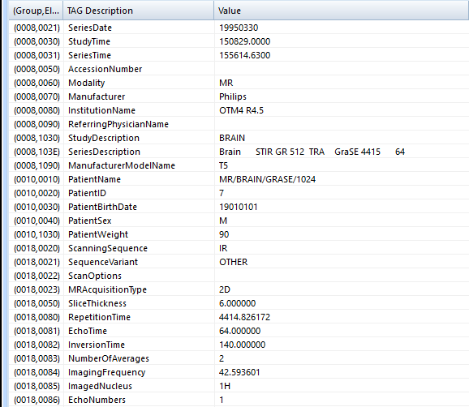
Everything Has a tag
Each data field has a unique tag or key
Tags are two 4-digit hexadecimal numbers

Slide 18
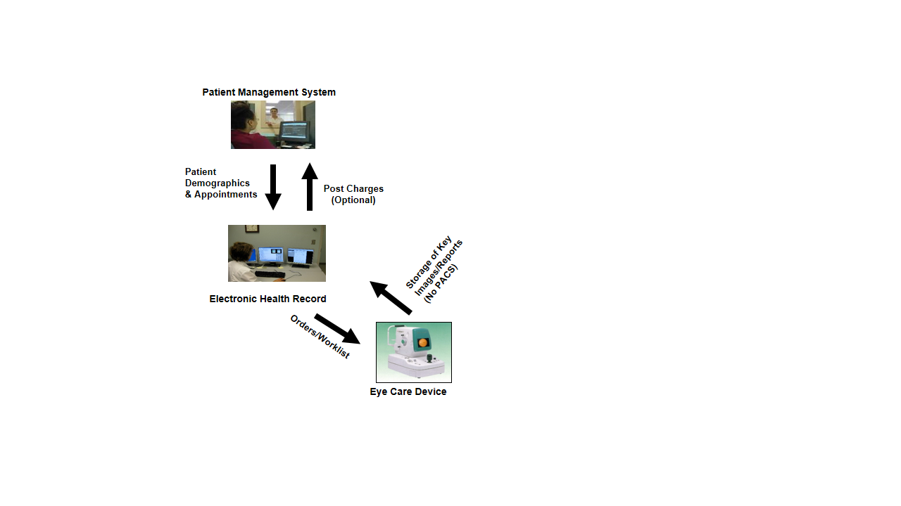
Real world model 1

Slide 19
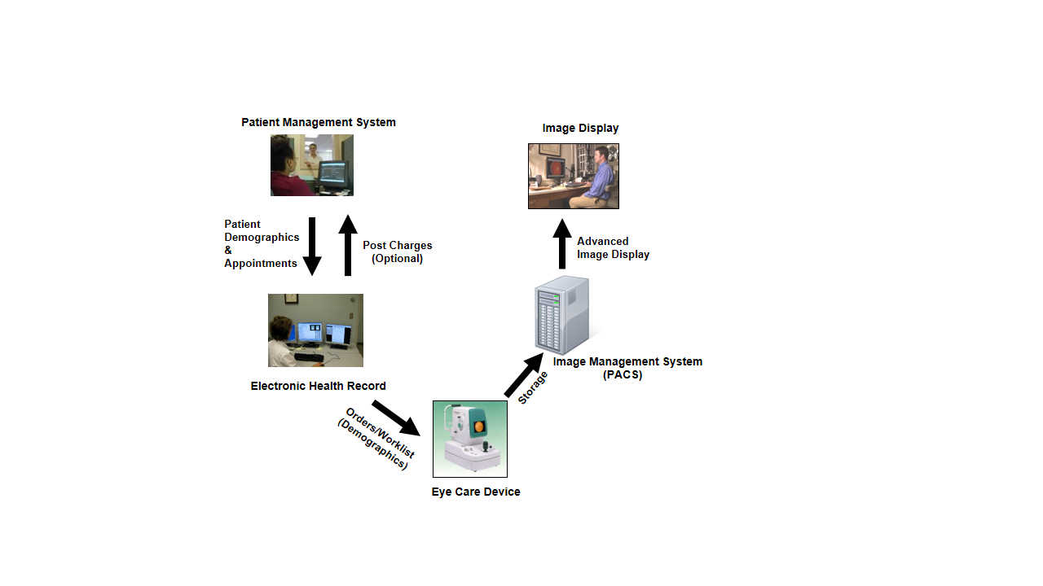
Real world model 2

Slide 20

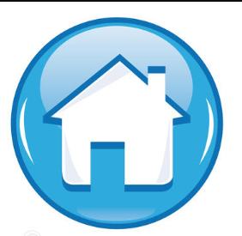
Thank You !

